Slide 1

On the Pros and Cons
of Earmarking Taxes
in Sub-Saharan Africa
A new de jure inventory of statutory revenue assignments across 19 countries
Alexandra Amani
Fund Internship Program | African Department
Supervisors: Julien Reynaud & Luc Tucker

Slide 2
Financing needs are largest in poorer countries and in SSA
Motivation
18.7% of GDP additional annual spending needs in IDA countries to meet core development needs and address climate risk. Education 6.0%, Health 5.3%
Tax-to-GDP rose +3.5 pp in LIDCs, +5 pp in EMEs since the early 1990s. Nearly all that gain predates the last decade, no material progress since
Fragile and conflict-affected states and resource-rich countries collect even less
FCS: weak institutions, corruption, low transparency depress collection (Mansour and Schneider, 2019)
Recent DRM reports catalogue obstacles and reform options, but are silent on earmarking
The standard paradigm reflects first-best recommendations and advanced economies experience
Do SSA conditions change the recommendation?
Source: IMF & World Bank (2024), Stepping Up Domestic Resource Mobilization: A New Joint Initiative from the IMF and World Bank.
International Monetary Fund | African Department
2

Slide 3
The objective
Motivation
Map the prevalence, legal design and source/destination structure of statutory revenue earmarking across 19 Sub-Saharan Africa countries.
How prevalent is earmarking in Sub-Saharan Africa?
How is it structured in law?
Which revenues finance which purposes?
International Monetary Fund | African Department
3

Slide 4
Outline
Literature Review
Taxonomy
Methodology to build the database with LLMs
Stylized facts
International Monetary Fund | African Department
4

Slide 5
The evidence is mixed and particularly thin for SSA
Literature
Channel | Mechanism / theory | Selected evidence
Political authorization Can increase support or facilitate passage in specific settings | Linking a tax to a service can make fiscal choices more transparent and allow service-by-service adjustment (Buchanan, 1963). Earmarking can also act as a commitment device when future use of revenues is uncertain (Brett & Keen, 2000). | Mexico: an exclusive-use statement increased stated support for a hypothetical tax by about 7–8 pp (Flores-Macías, 2018). Ghana: the GET Fund was used as part of the political strategy to secure passage of a VAT increase (Prichard, 2015).
Compliance & net revenue The sign and magnitude remain unresolved | A credible link to valued services may improve compliance in low-trust settings (Teja, 1988). But strong prior beliefs about corruption may make revenue-use messages insufficient to change behavior (Luttmer & Singhal, 2014). | Tax visibility, incidence, remittance arrangements and collective organization condition taxpayers' political and behavioural responses (Prichard, 2009; 2015).
Additional spending Legal dedication does not necessarily generate additional spending | An earmark is substantive only if dedicated revenue becomes a marginal source of spending, rather than replacing general-fund support (Bird & Jun, 2005). | African road-fund cases show that statutory resources can be frozen, diverted or weakened by non-payment, limiting effective additionality (McCleary, 1991).
Expenditure quality / PFM Effects depend strongly on institutions and implementation capacity | Dedicated resources must still be transferred, released and converted into effective expenditure. | PFM quality, absorptive capacity, release mechanisms and periodic review condition whether earmarked resources can be used effectively (Cashin, Sparkes & Bloom, 2017).
International Monetary Fund | African Department
5

Slide 6
Earmarking can affect several stages of the fiscal process
Mechanisms
Earmarking can matter at several distinct stages, from legal design to expenditure outcomes.
De jure
design
Political
authorization
Revenue
realization
Budget
translation
Expenditure
outcomes
What does the law commit?
Can the tax be adopted or sustained?
Does it affect collection and the tax base?
Are revenues transferred and additional?
Are resources used effectively?
Source: Prichard (2015); Bird & Jun (2005); Cashin, Sparkes & Bloom (2017); Allen & Radev (2006); Flores-Macías (2018).
International Monetary Fund | African Department
6

Slide 7
Before asking whether earmarking works: where does it exist?
Contribution
The missing layer is the legal link between the revenue source and its statutory destination.
How prevalent?
Which revenues?
Assigned to what?
STANDARD REVENUE STATISTICS
STATUTORY DESTINATION
VAT · CIT · PIT · EXCISES
?
recipient / purpose
In the literature, we find no comparable cross-country legal inventory for SSA that provides an instrument level denominator and statutory source to destination mapping.
We build database covering 19 countries, 435 assigned revenue instruments
209 earmarked instruments and 433 allocation channels attached to them
International Monetary Fund | African Department
7

Slide 8
Operational definition of an earmark
Taxonomy
Is the payment requited?
Does the law restrict what the proceeds may finance?
Earmarked channel
Statutory clauses assigning proceeds
1
2
Proceeds restricted by law to a stated function — a fund, an agency's mandate, or a programme — at any level of government.
requited
unrestricted
The only branch retained as an earmark.
REMOVED BY THE SCREENS
Cost recovery
Unrestricted assignment
A price for a service, not a dedication of revenue.
The proceeds move, but nothing constrains what they finance: general budget
International Monetary Fund | African Department
8

Slide 9
Operational definition of an earmark
Taxonomy
Revenue instrument assigned, use unrestricted
The law names a destination but not a purpose revenue sharing, transfers to territorial tiers
Assigned, use unrestricted
Taxe sur la consommation domestique d'eau et d'électricité
Whole proceeds → budget communal — the commune's own budget
The revenue moves, but nothing constrains its use. Decentralisation, not earmarking.
Partial earmark
Part of the proceeds is tied to a purpose; the rest is not
Exclusive earmark
Every share of the proceeds is tied to a stated purpose. Nothing reaches the general budget.
International Monetary Fund | African Department
9

Slide 10
Operational definition of an earmark
Taxonomy
Revenue instrument assigned, use unrestricted
The law names a destination but not a purpose revenue sharing, transfers to territorial tiers
Partial earmark
Taxe sur les activités polluantes
Partial earmark
Part of the proceeds is tied to a purpose; the rest is not
40 % → Budget de l'État
40 % → Ministère de l'Environnement
20 % → CIAPOL, the pollution control agency
Exclusive earmark
Every share of the proceeds is tied to a stated purpose. Nothing reaches the general budget.
A corrective tax whose dedication competes directly with the Treasury.
International Monetary Fund | African Department
9

Slide 11
Operational definition of an earmark
Taxonomy
Revenue instrument assigned, use unrestricted
The law names a destination but not a purpose revenue sharing, transfers to territorial tiers
Exclusive earmark
Taxe d'apprentissage
→ Fonds de Développement pour la Formation professionnelle
→ Fonds National de la Formation professionnelle initiale
A payroll levy financing training — the taxed base and the financed function coincide.
Partial earmark
Part of the proceeds is tied to a purpose; the rest is not
Exclusive earmark
Every share of the proceeds is tied to a stated purpose. Nothing reaches the general budget.
International Monetary Fund | African Department
9

Slide 12
One legal corpus feeds two linked databases
Methodology
A legal earmark needs both a revenue source and an enacting clause assigning its proceeds to a named recipient or stated purpose, in an enacting text.
DENOMINATOR
Database 1: Instrument census
NUMERATOR
Database 2: Earmark allocation
Every charge the law creates, earmarked or not.
Every legal link from a source to a destination.
1
Certify & read each legal document
1
Locate assignment-bearing passages
2
Extract one row per revenue instrument
2
Extract clause-level source & allocation evidence
3
Validate & save a per-document census
3
Reconcile instruments, channels & conflicts
4
Reconcile across documents when needed
4
Attach census link · classify destination (COFOG) · filter
Instrument census table
Earmark-allocation table
International Monetary Fund | African Department
10

Slide 13
The legal corpus is assembled differently depending on the legislation
Methodology
Francophone
Anglophone
One consolidated volume
A chain of separate Acts
Core source The latest Code général des impôts (CGI) or equivalent consolidated tax code.
Core sources Principal tax Acts, levy Acts, fund/agency Acts, finance Acts, schedules, regulations.
Extensions Fiscal annexes, finance laws, sectoral or fund-establishing texts, only to complete a chain.
Reconstruct the chain Budget and revenue lists identify the universe of taxes to trace: discovery tools, not evidence.
Where the earmark sits Source and assignment usually in the same volume.
Where the earmark sits Source and assignment may sit in different Acts.
International Monetary Fund | African Department
11

Slide 14
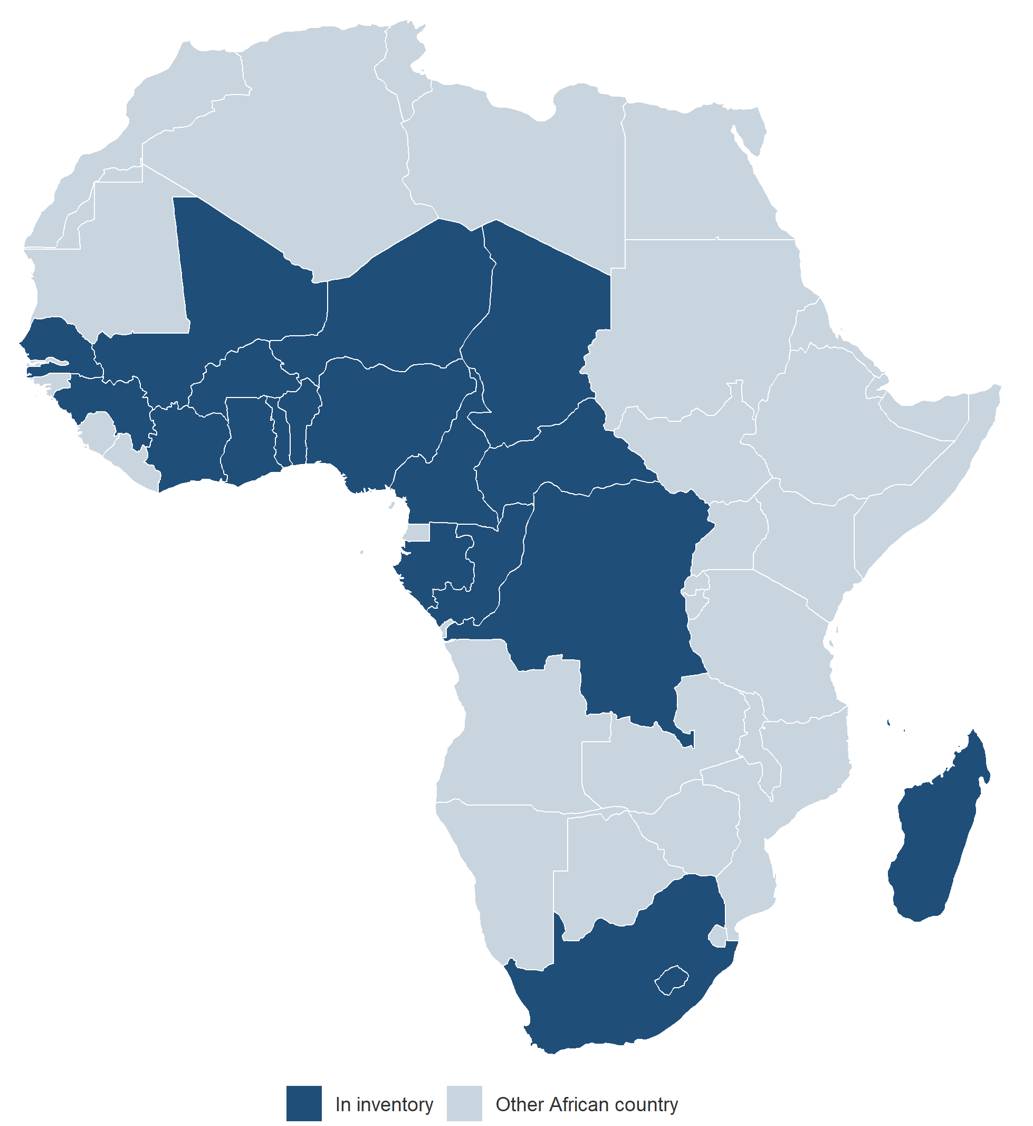
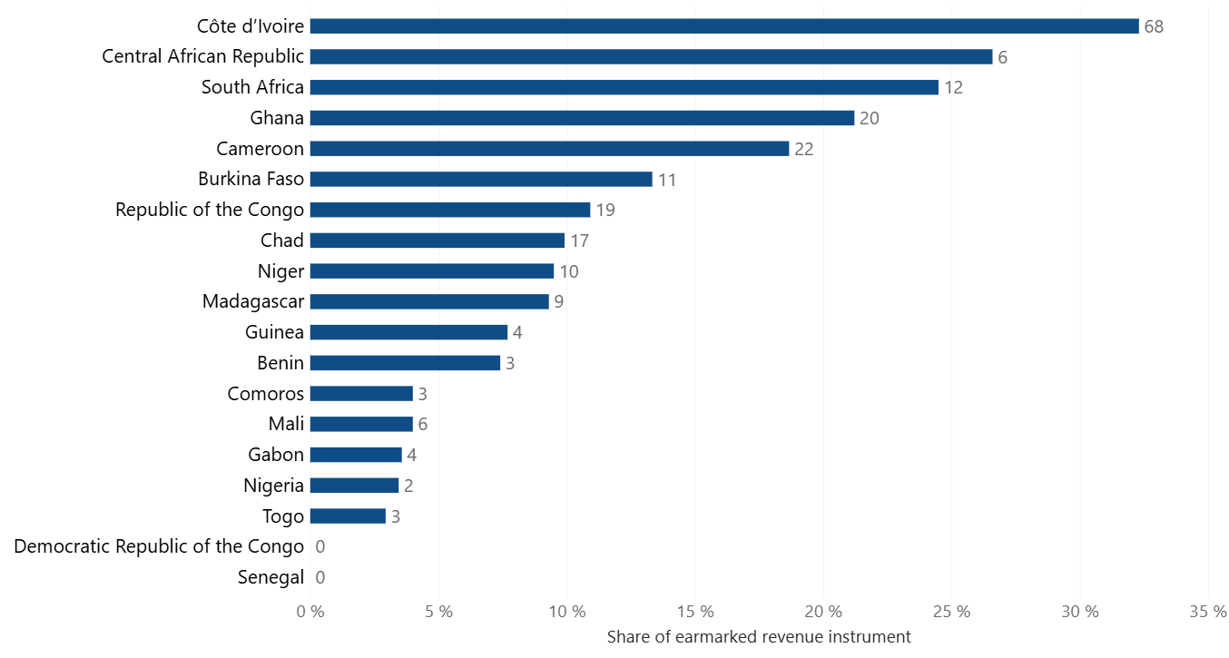
How common is statutory earmarking?
Stylized facts
International Monetary Fund | African Department
12

Slide 15
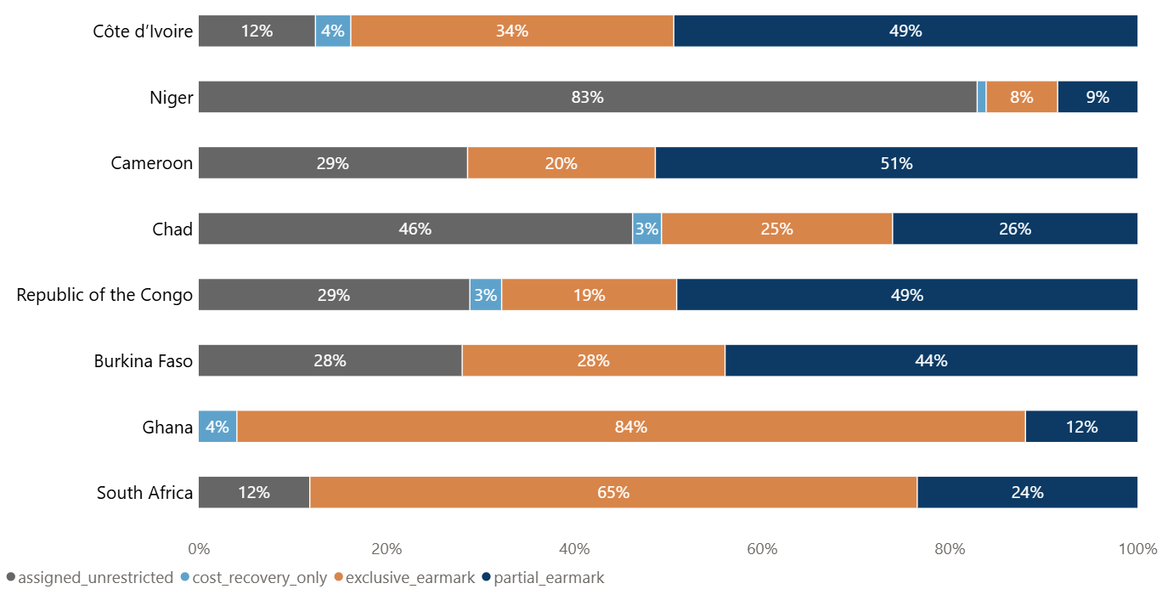
When governments earmark, how strongly do they do so?
Stylized facts
All countries
International Monetary Fund | African Department
13

Slide 16
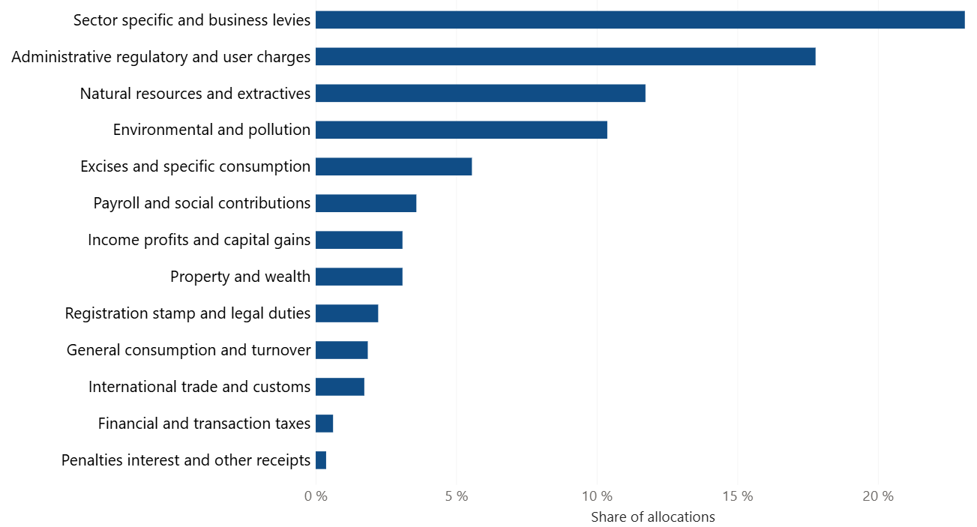
What types of revenues are governments willing to tie?
Stylized facts
International Monetary Fund | African Department
14

Slide 17
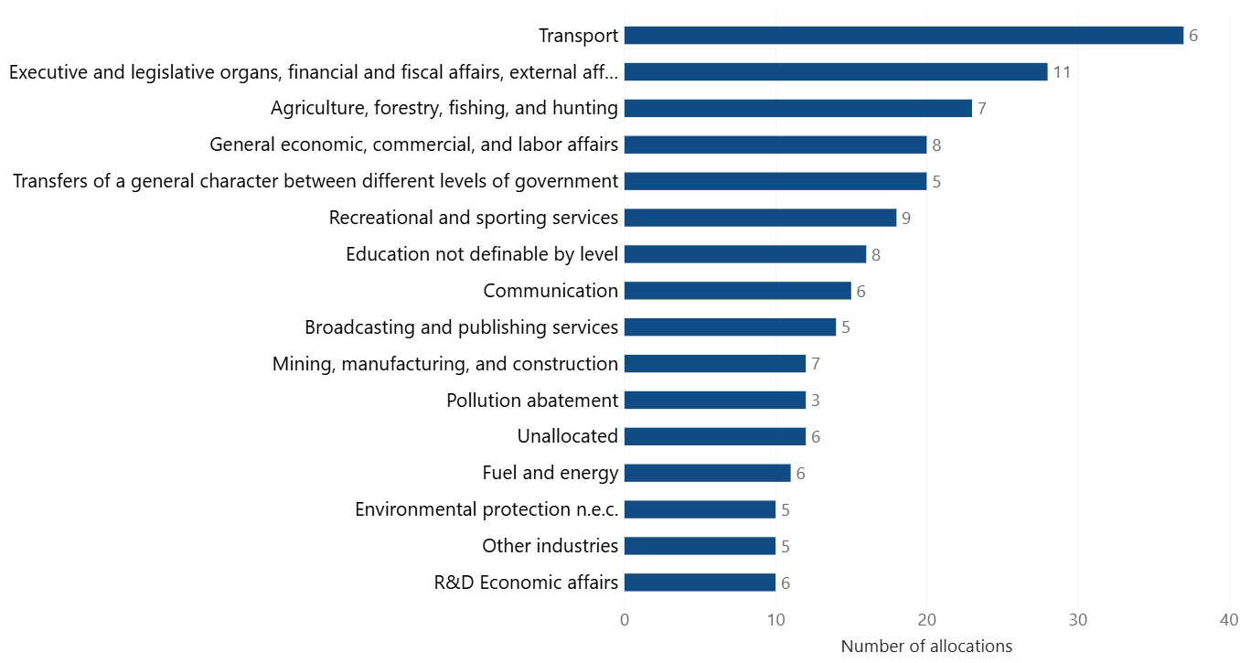
What is earmarking used to finance?
Stylized facts
International Monetary Fund | African Department
15

Slide 18
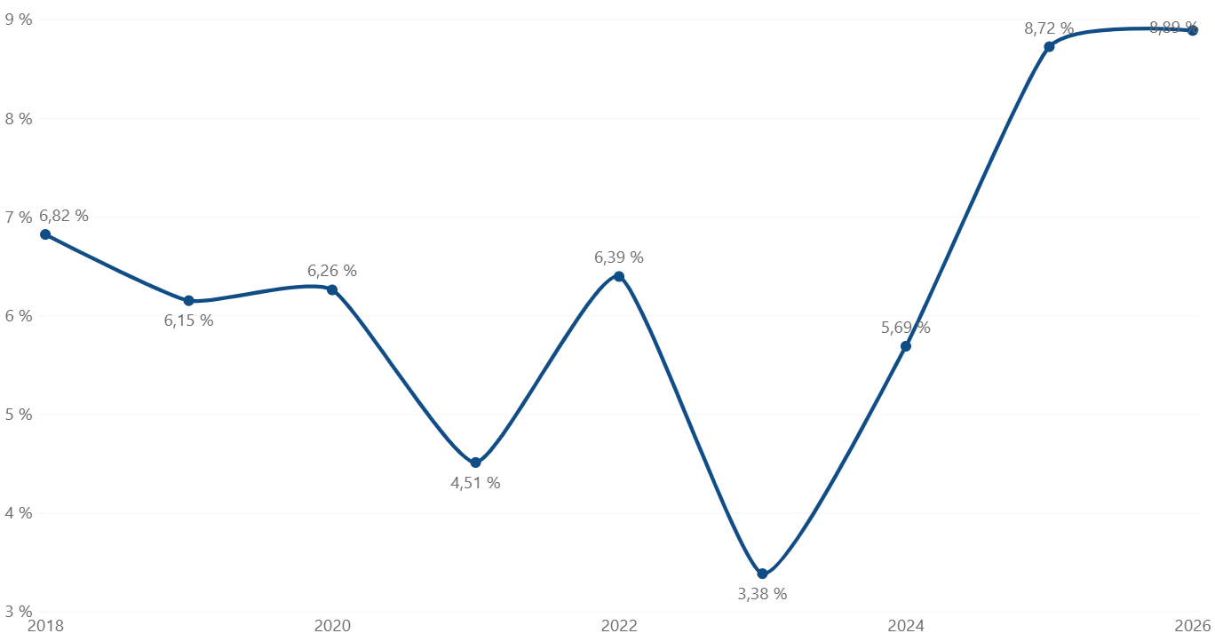
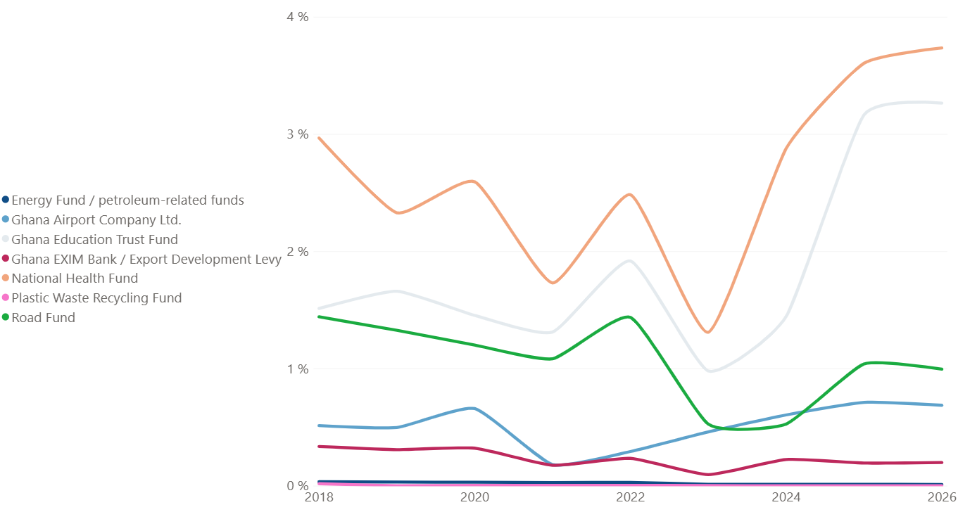
Ghana Illustration – Budget rigidity
Stylized facts
Budget allocations to earmarked funds as a share of Ghana’s total budget 2018 - 2026
Budget allocation to each earmarked fund as a share of total government expenditure, 2018–2026
International Monetary Fund | African Department
16

Slide 19
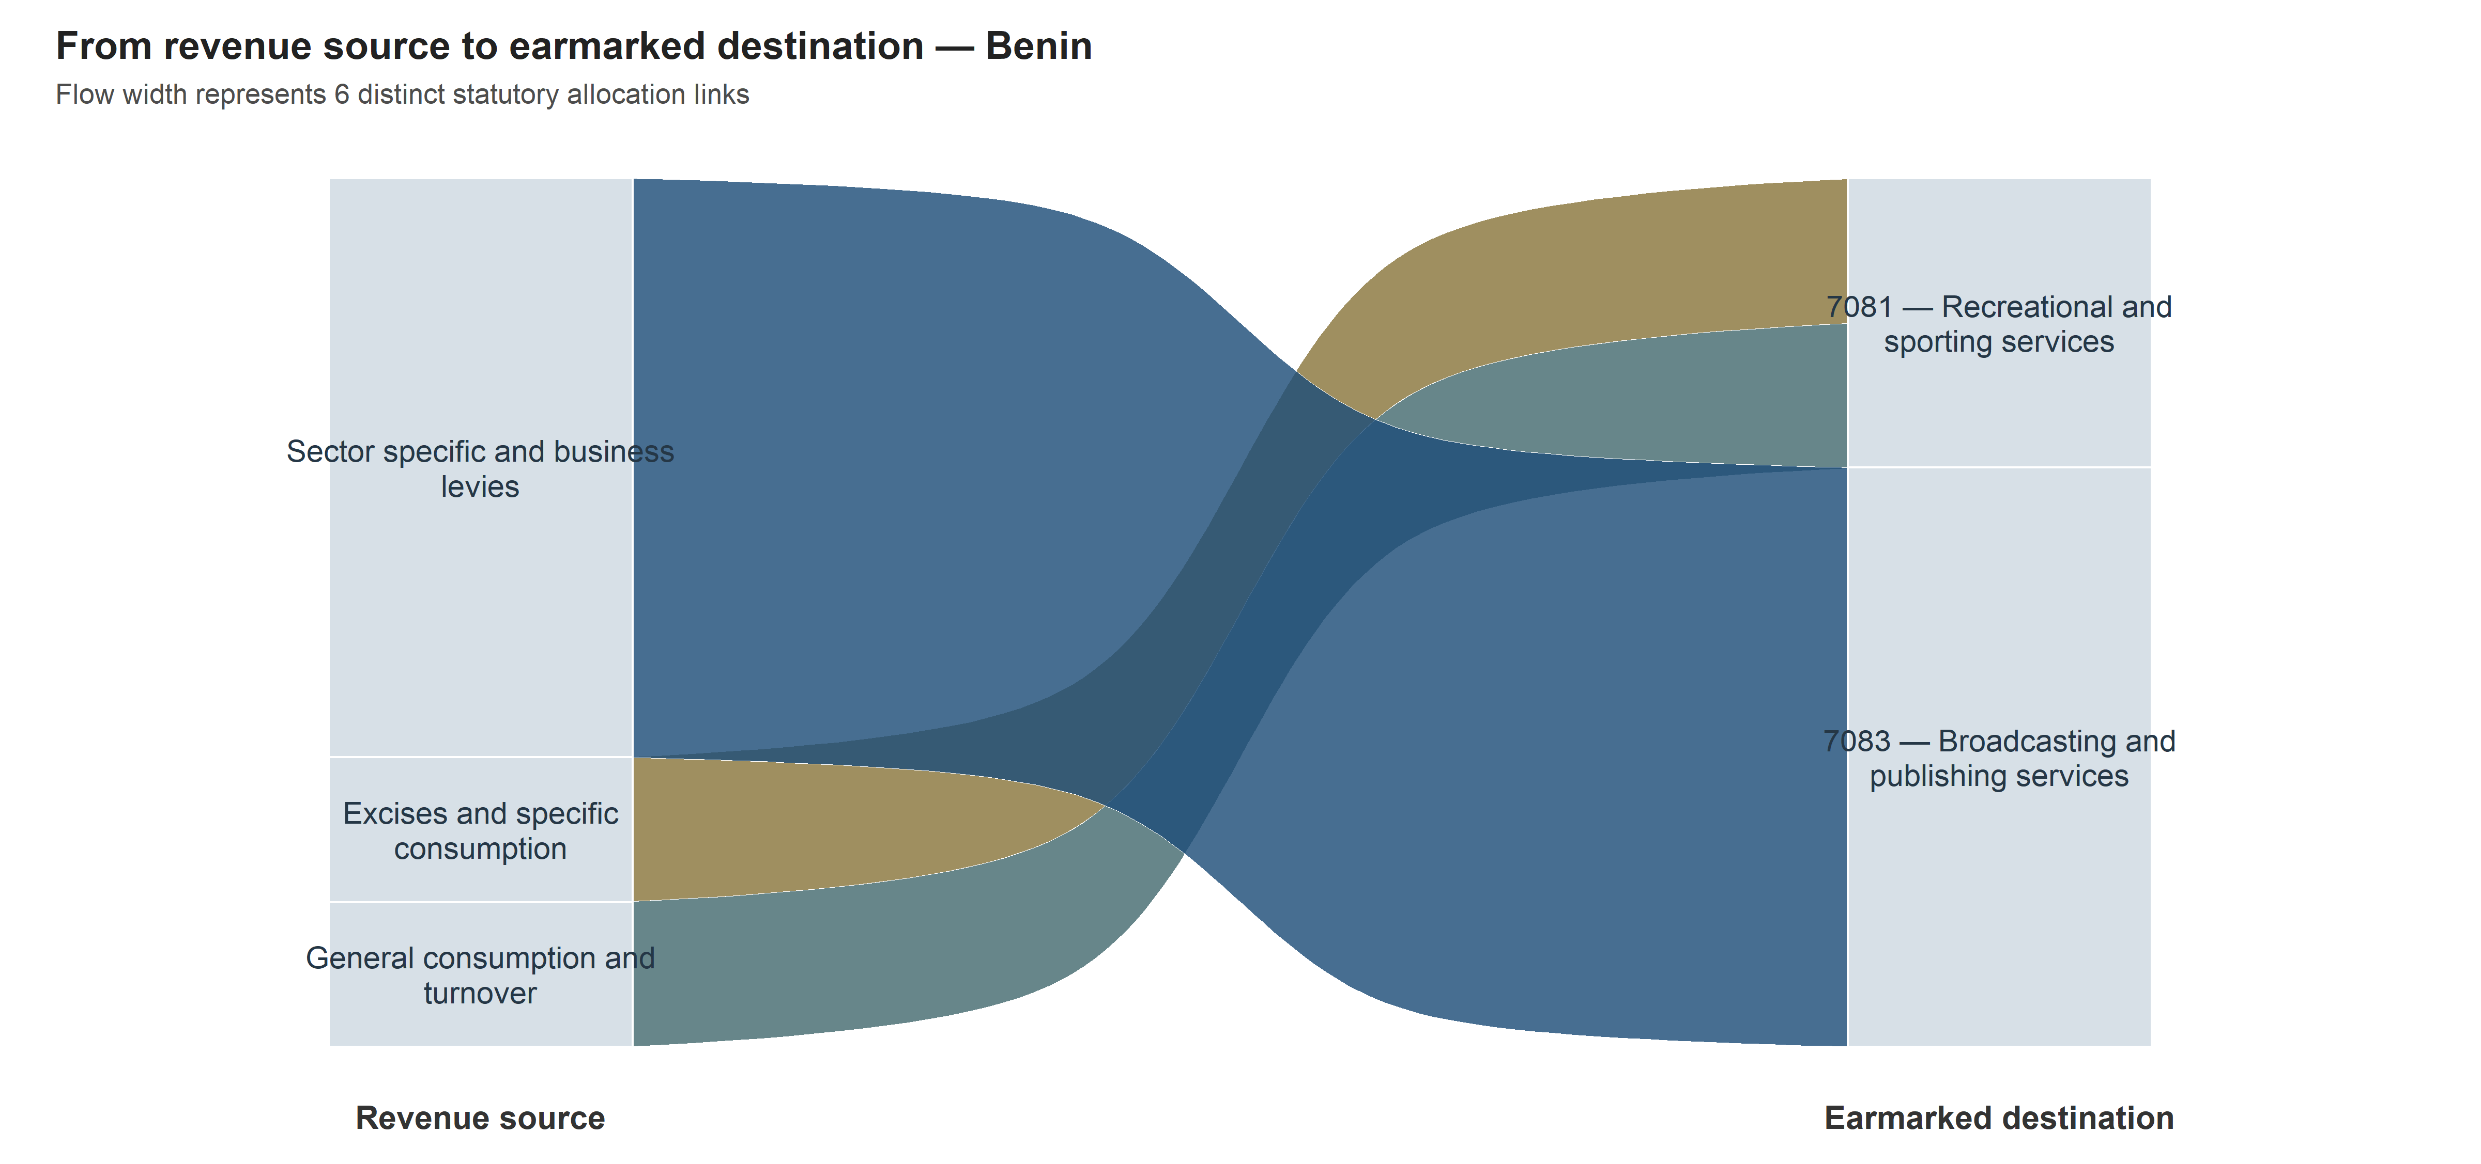
Do countries use earmarking in fundamentally different ways?
Stylized facts
International Monetary Fund | African Department
17

Slide 20
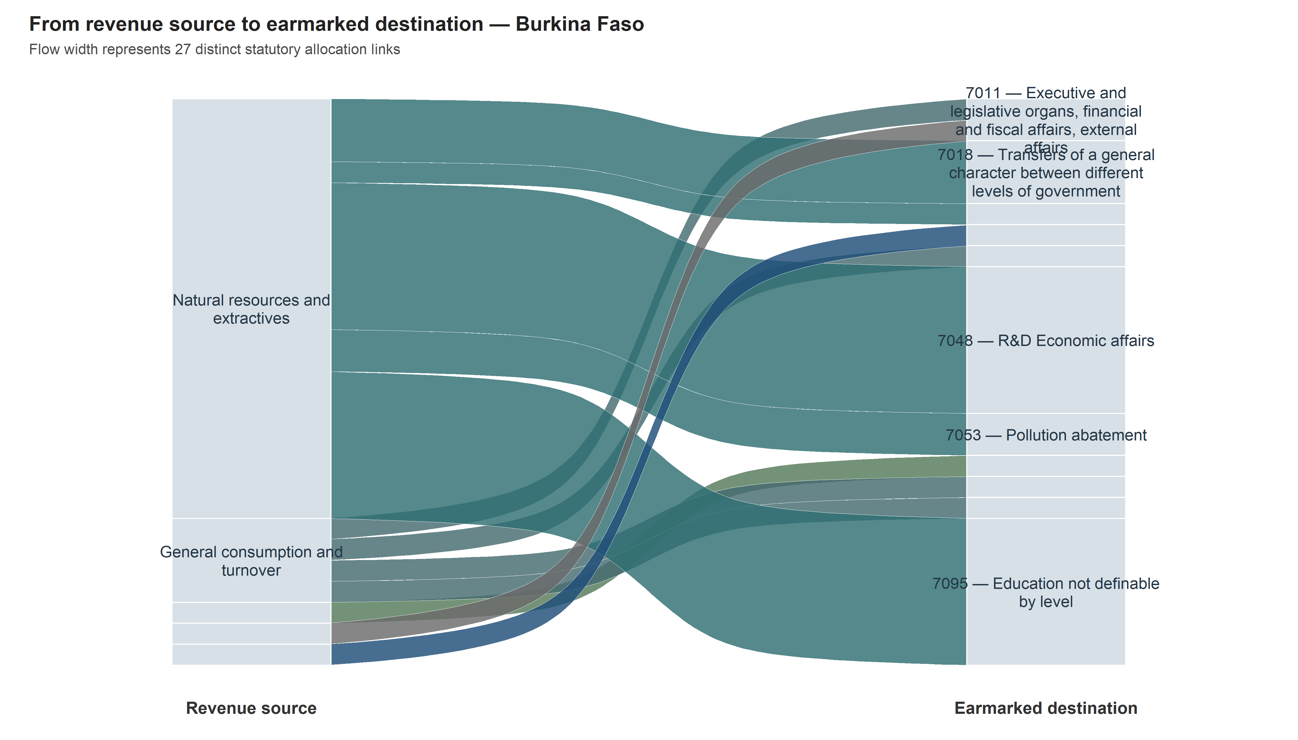
Do countries use earmarking in fundamentally different ways?
Stylized facts
International Monetary Fund | African Department
18

Slide 21
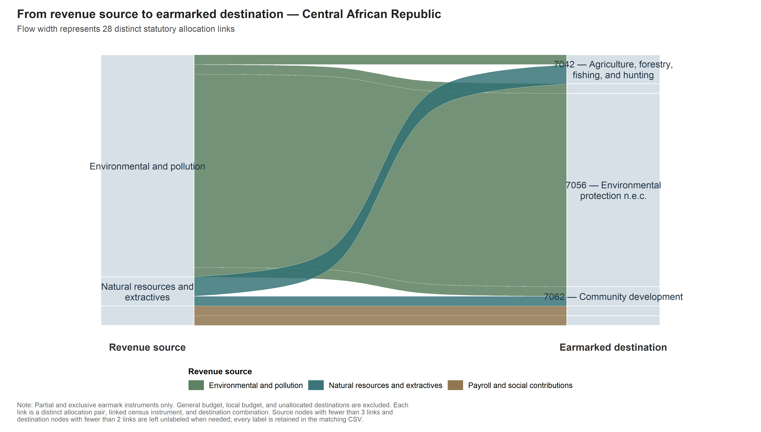
Do countries use earmarking in fundamentally different ways?
Stylized facts
International Monetary Fund | African Department
19

Slide 22
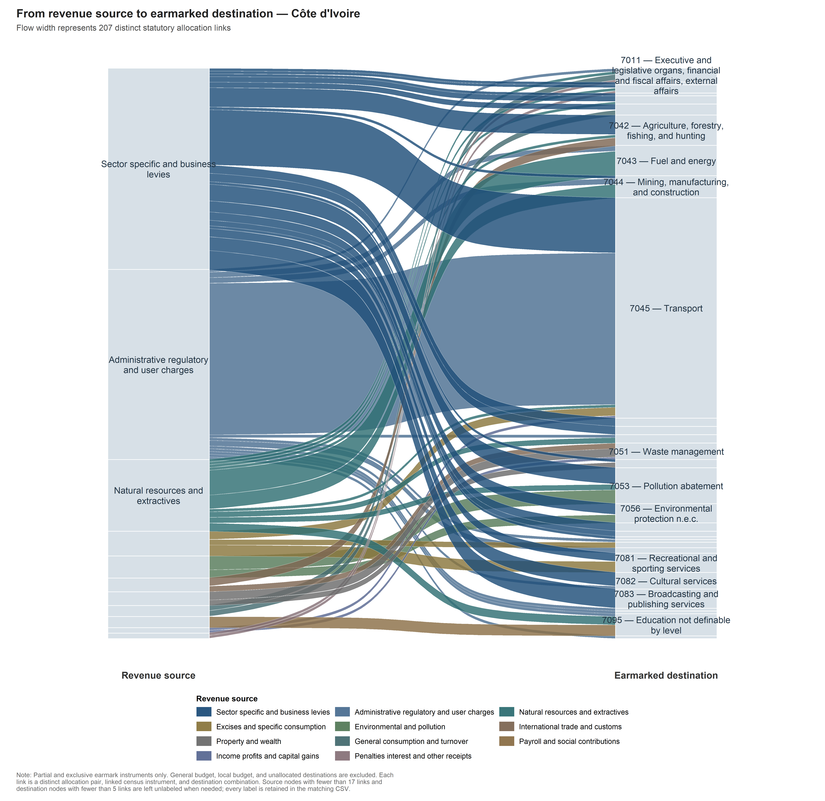
Do countries use earmarking in fundamentally different ways?
Stylized facts
International Monetary Fund | African Department
20

Slide 23
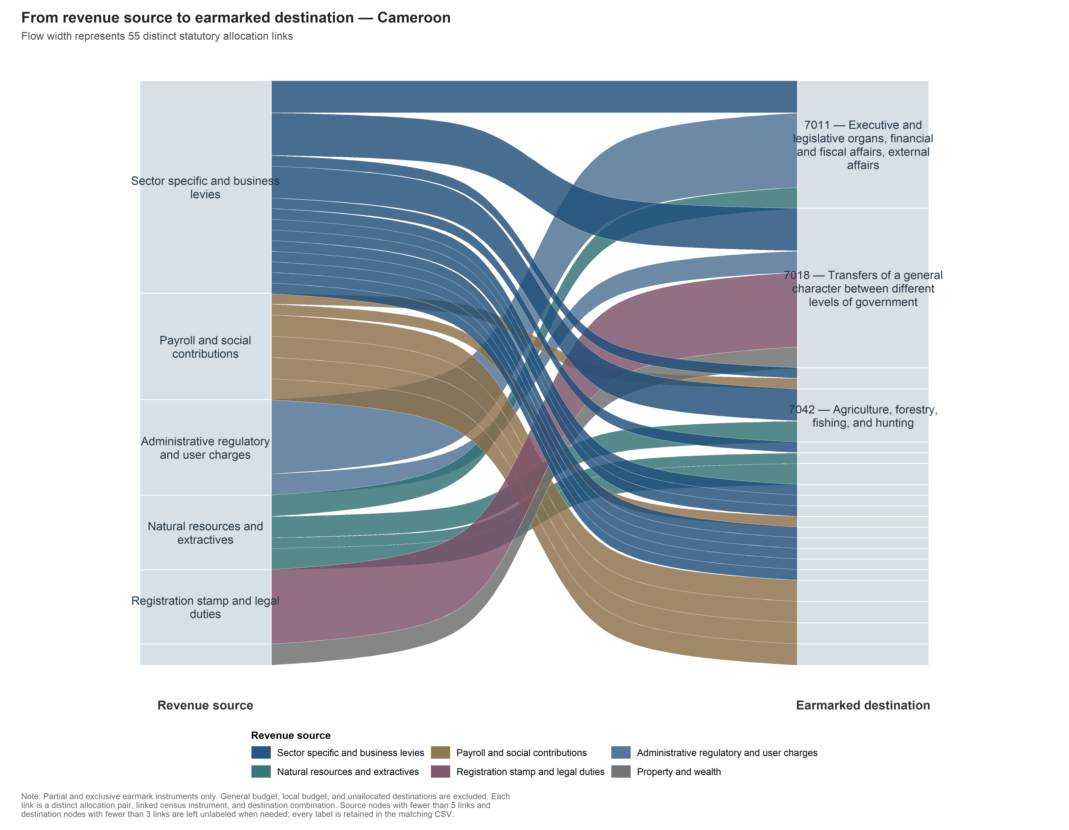
Do countries use earmarking in fundamentally different ways?
Stylized facts
International Monetary Fund | African Department
21

Slide 24
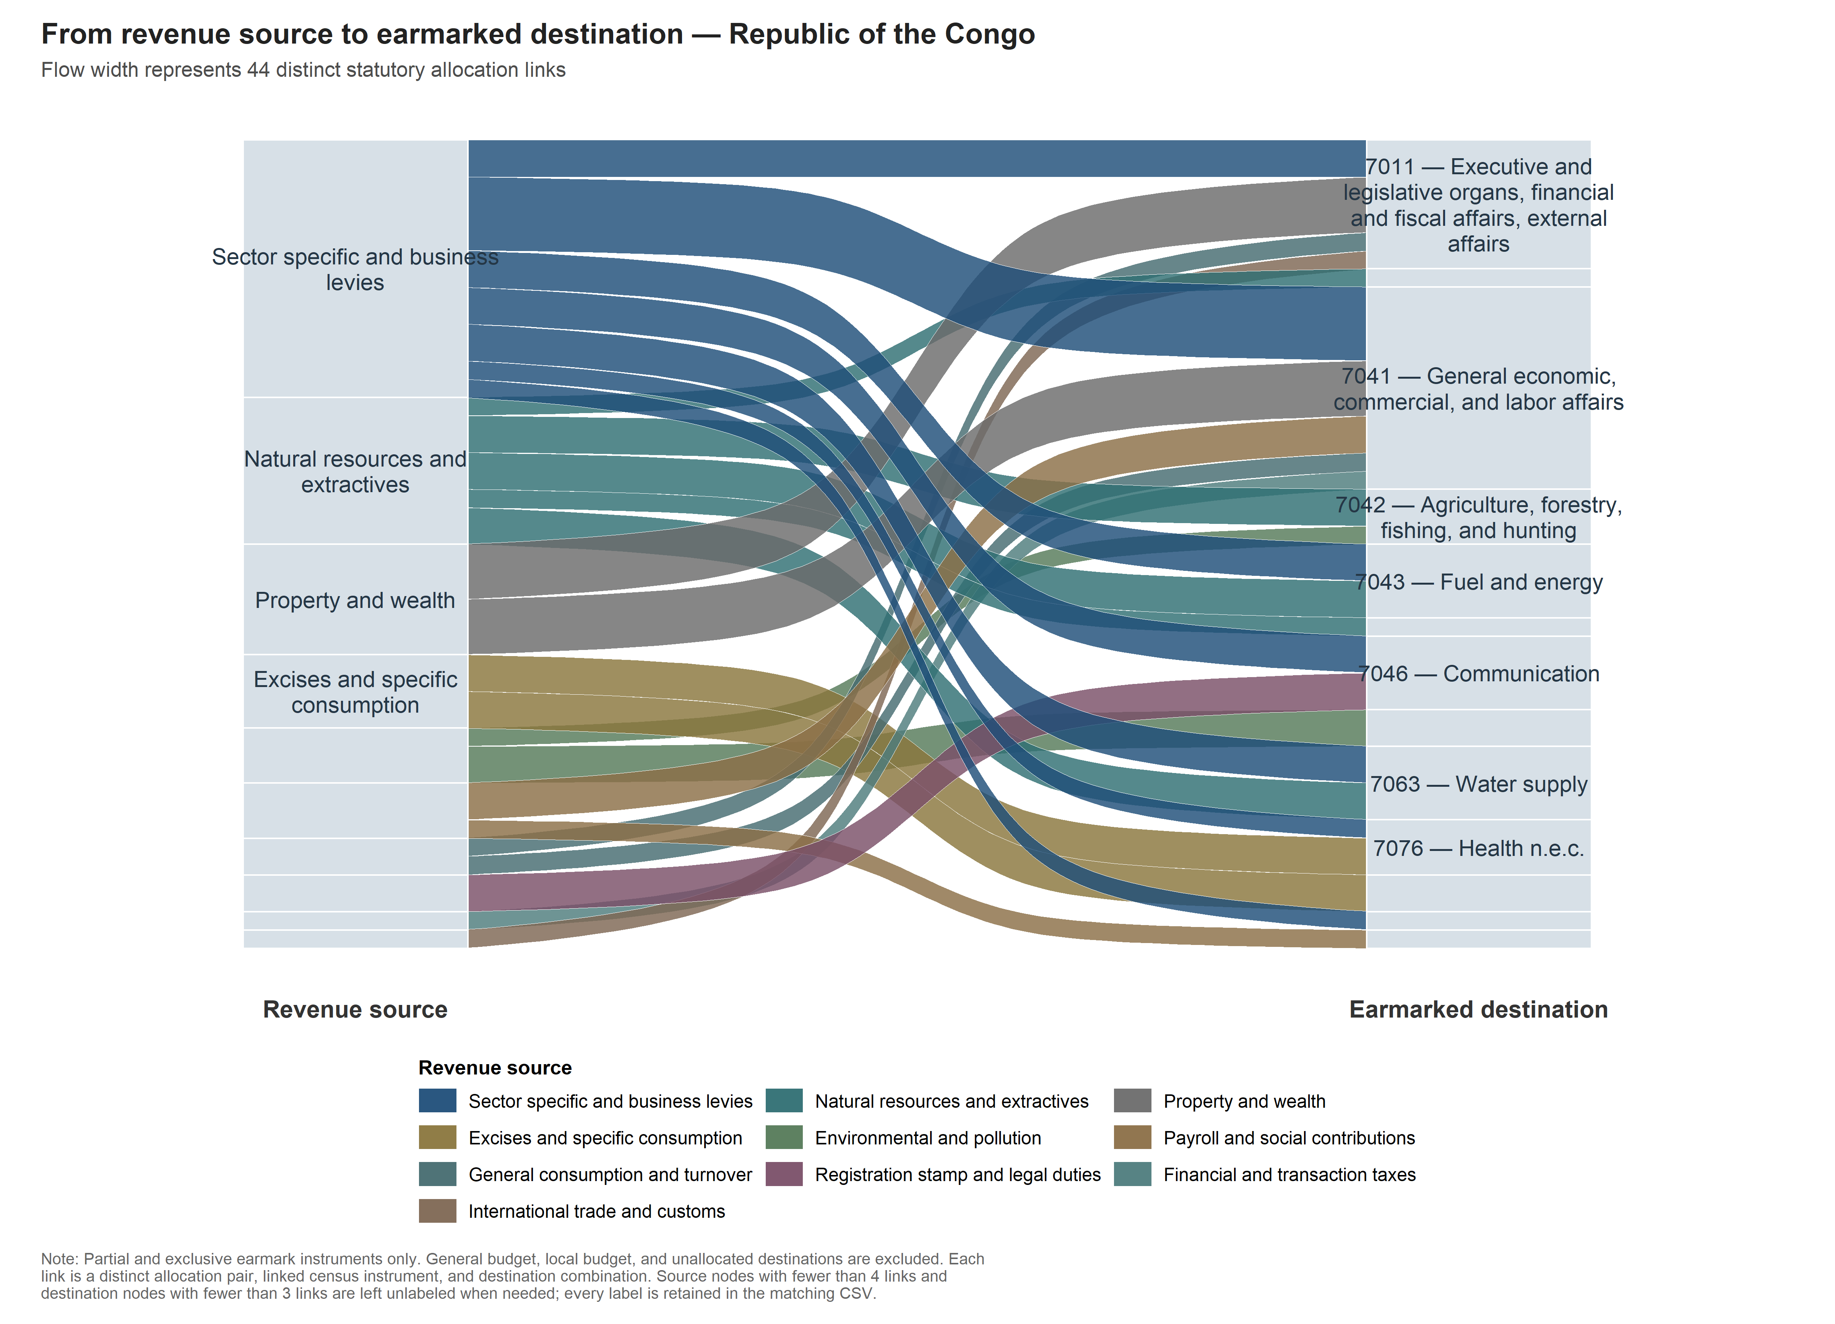
Do countries use earmarking in fundamentally different ways?
Stylized facts
International Monetary Fund | African Department
22

Slide 25
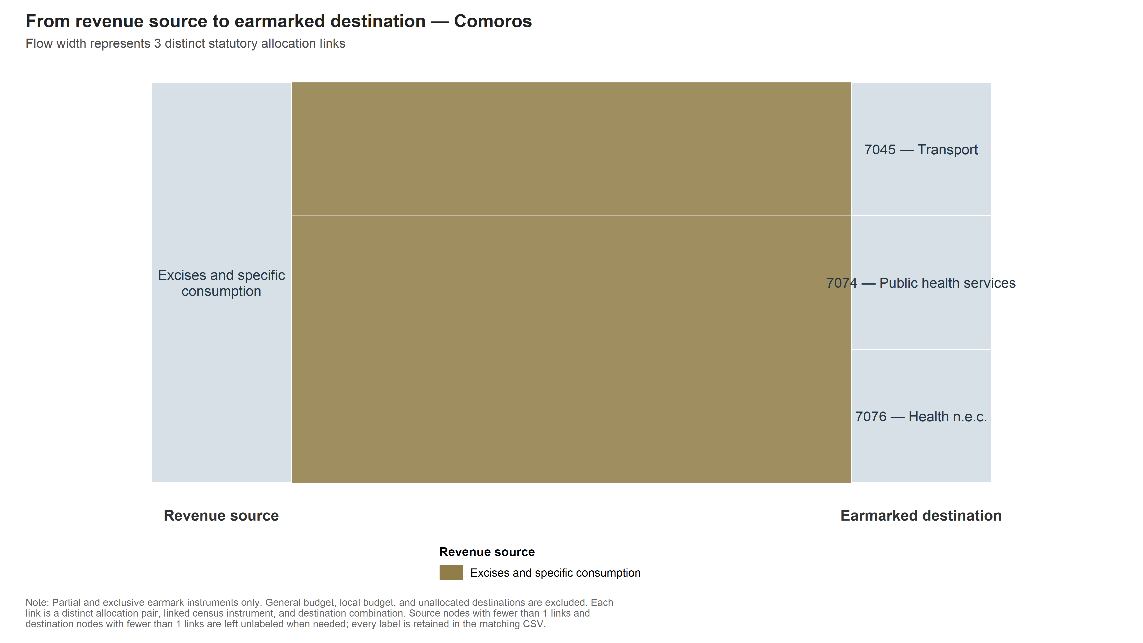
Do countries use earmarking in fundamentally different ways?
Stylized facts
International Monetary Fund | African Department
23

Slide 26
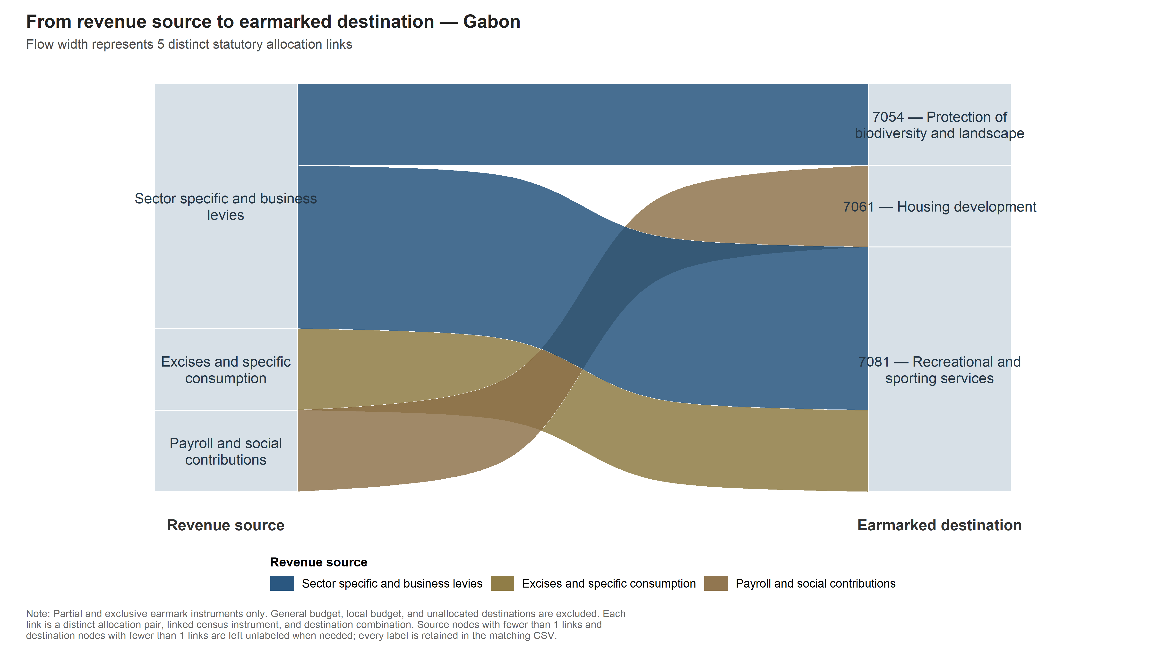
Do countries use earmarking in fundamentally different ways?
Stylized facts
International Monetary Fund | African Department
24

Slide 27
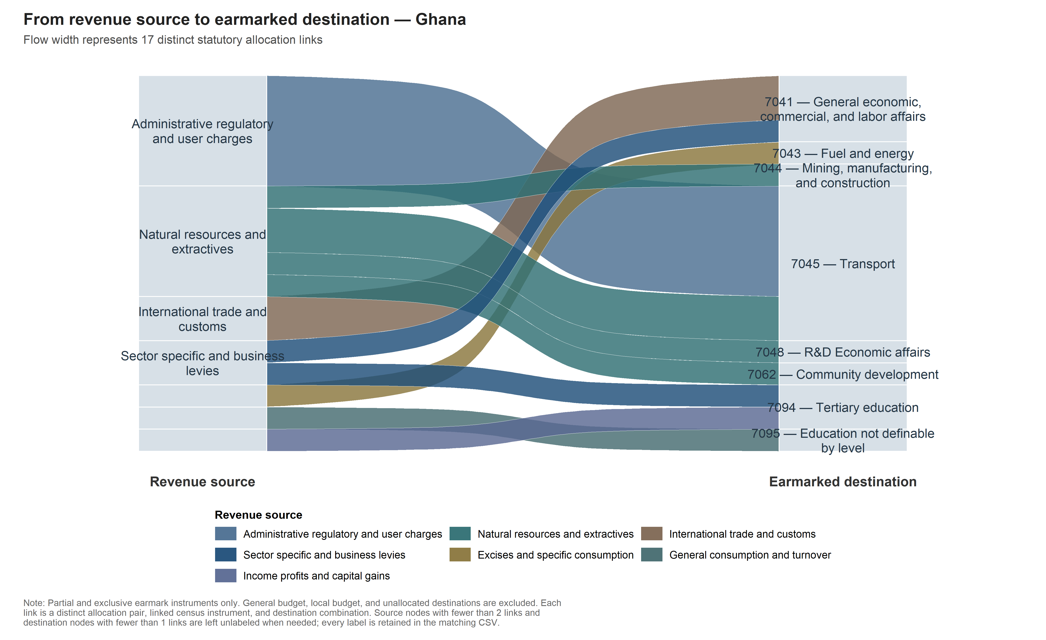
Do countries use earmarking in fundamentally different ways?
Stylized facts
International Monetary Fund | African Department
25

Slide 28
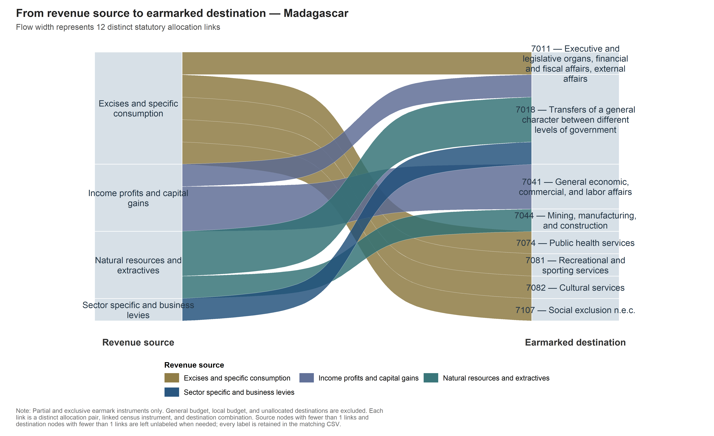
Do countries use earmarking in fundamentally different ways?
Stylized facts
International Monetary Fund | African Department
26

Slide 29
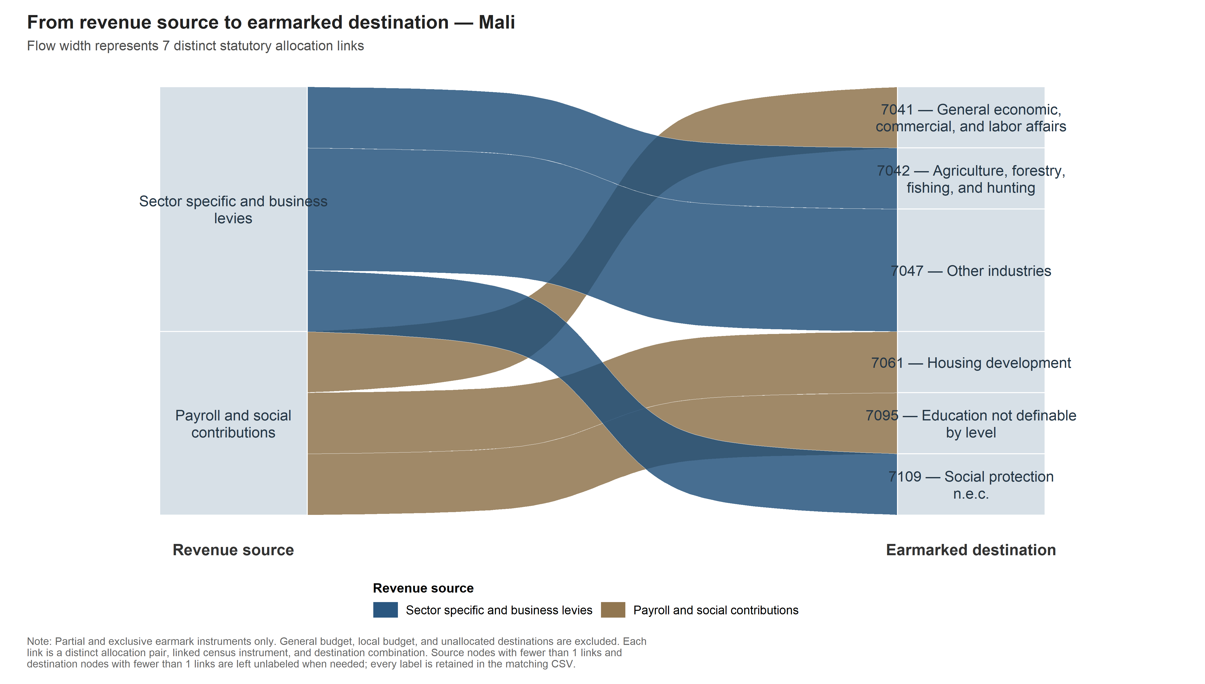
Do countries use earmarking in fundamentally different ways?
Stylized facts
International Monetary Fund | African Department
27

Slide 30
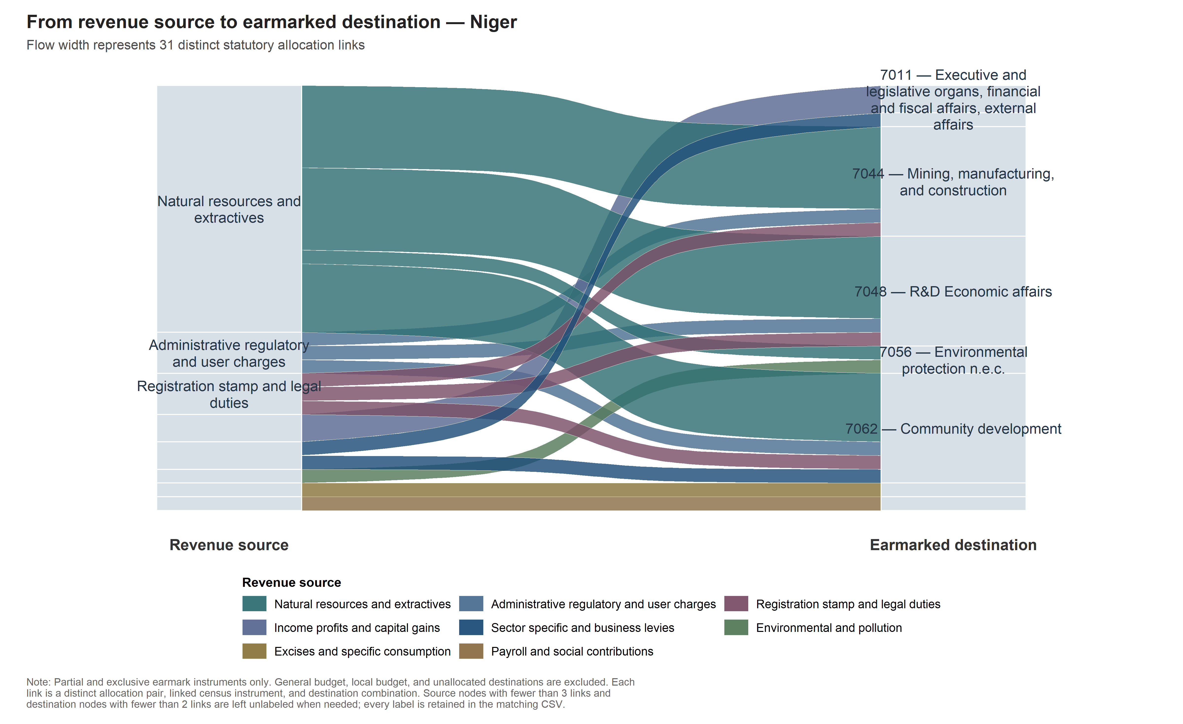
Do countries use earmarking in fundamentally different ways?
Stylized facts
International Monetary Fund | African Department
28

Slide 31
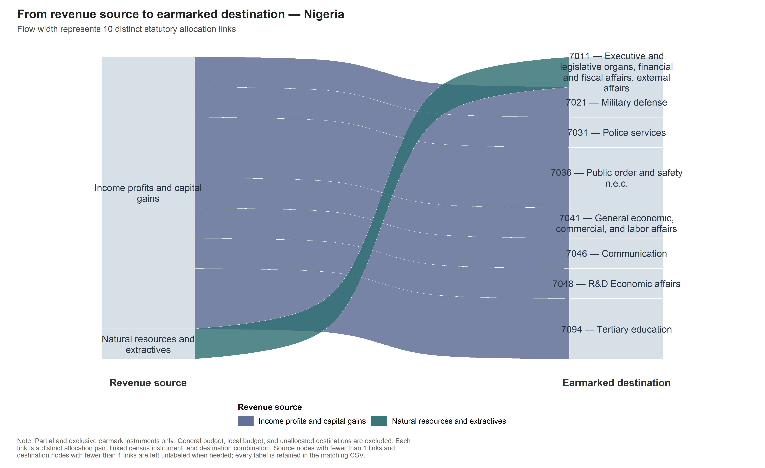
Do countries use earmarking in fundamentally different ways?
Stylized facts
International Monetary Fund | African Department
29

Slide 32
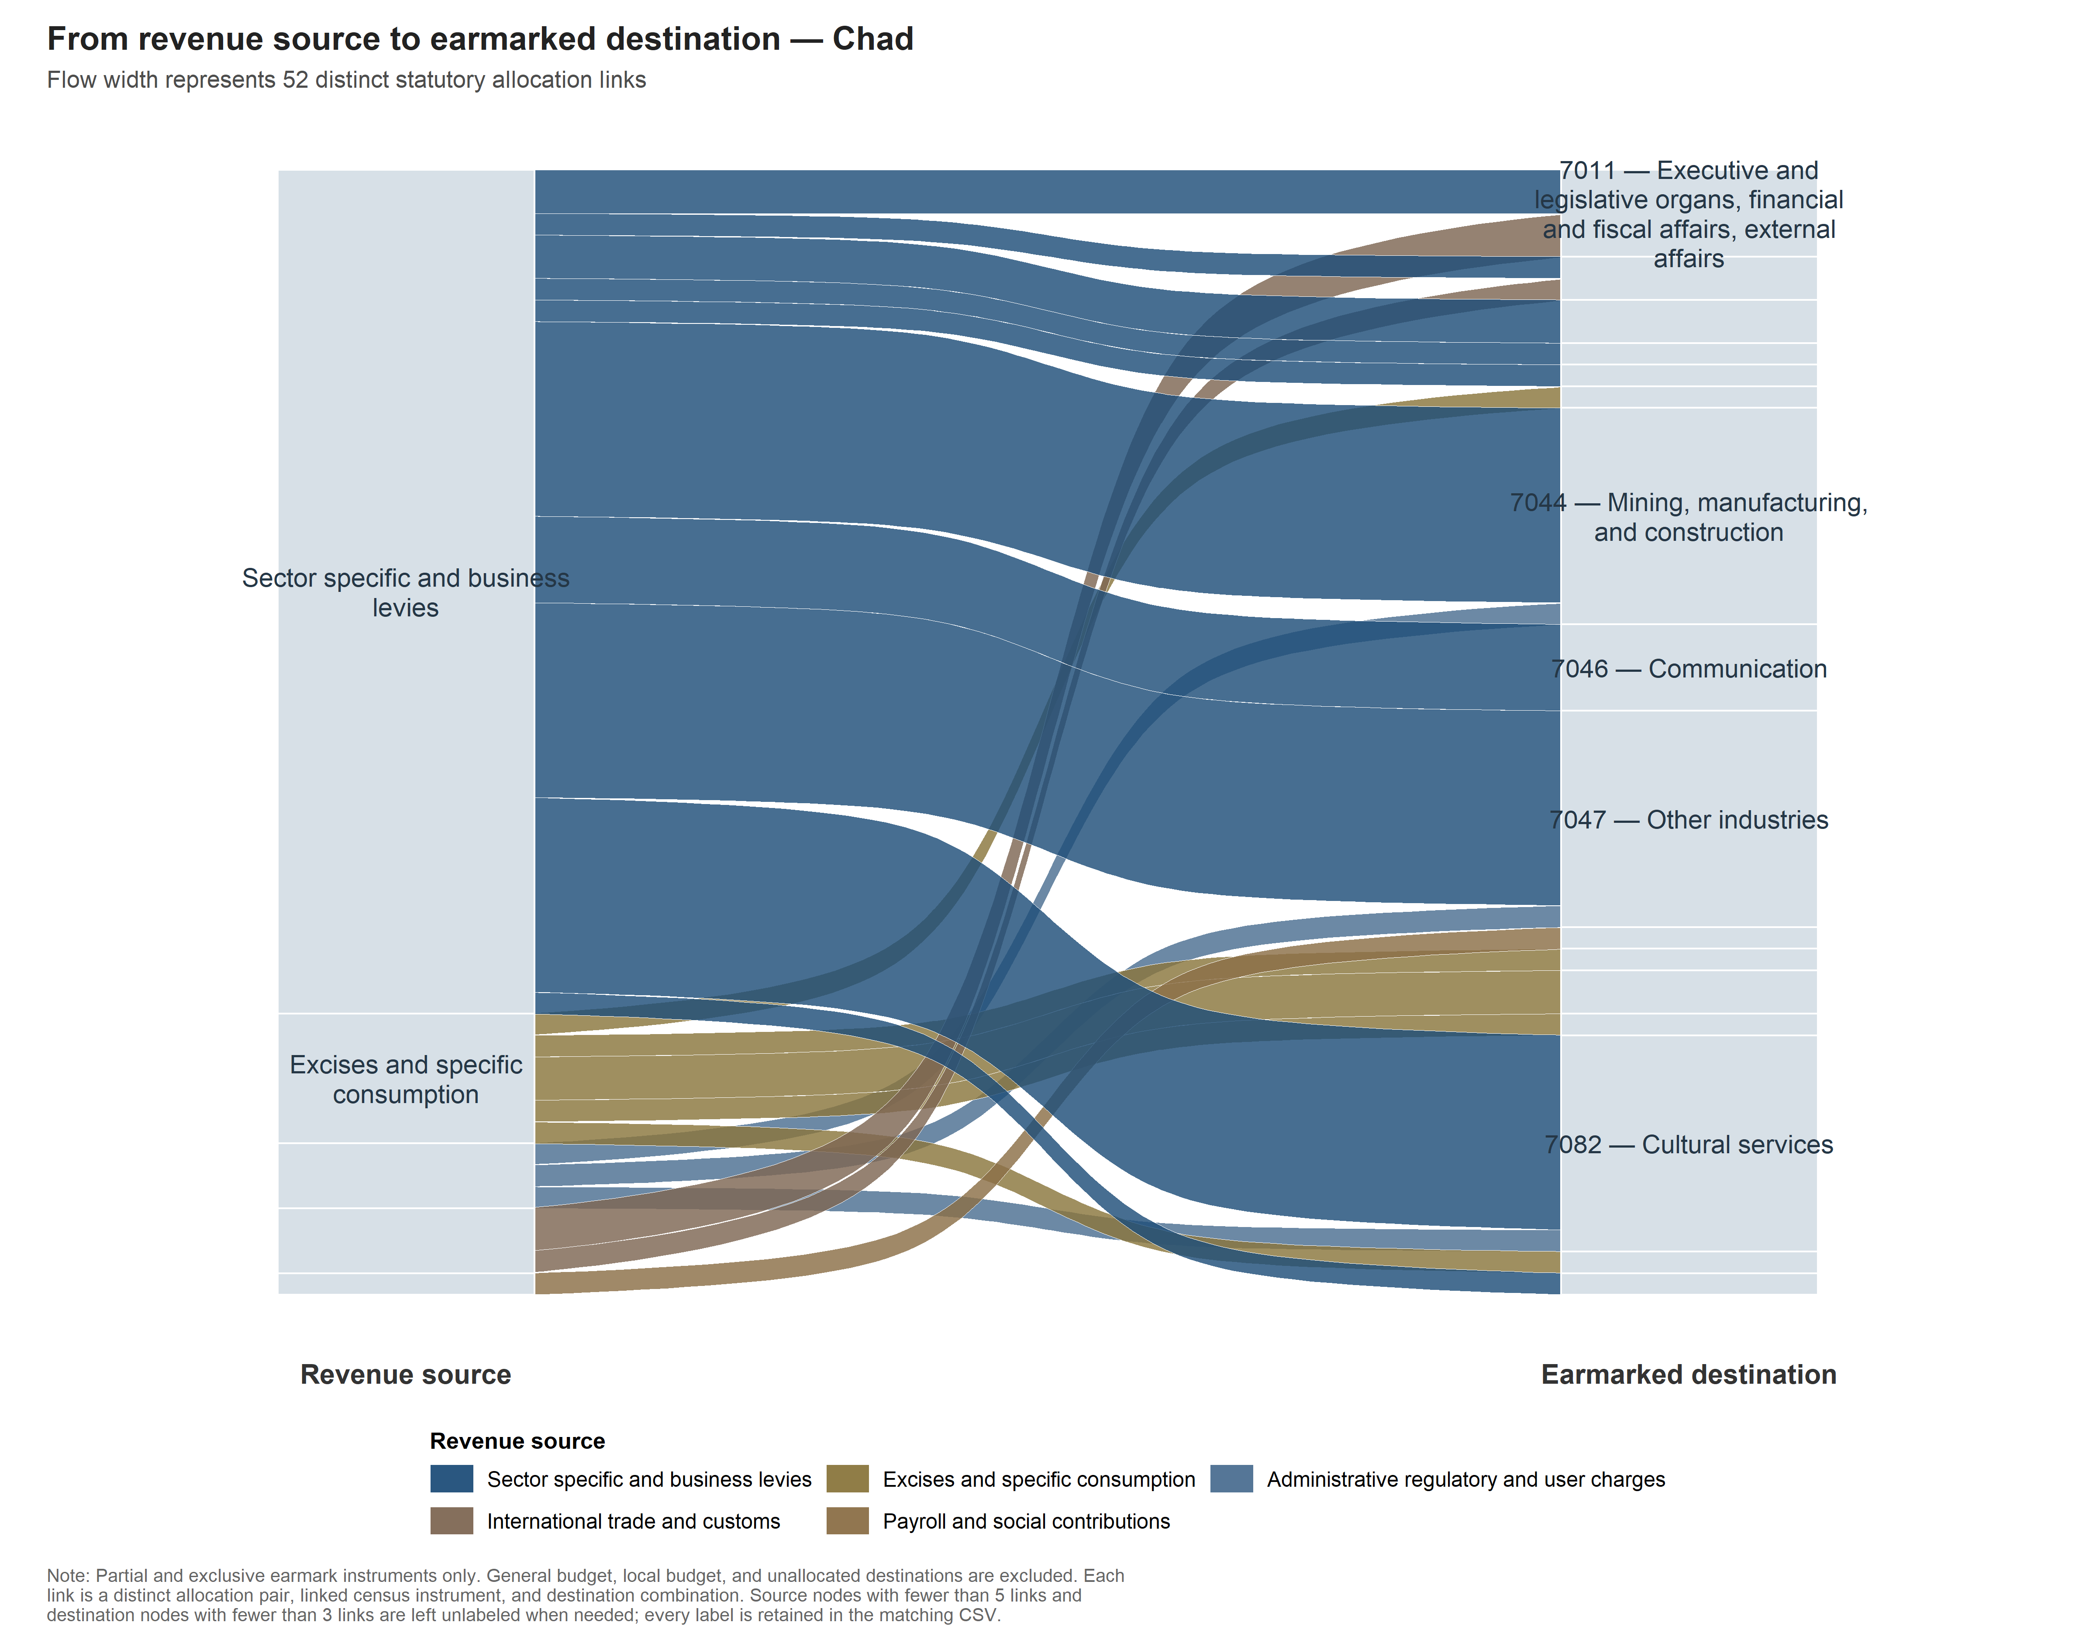
Do countries use earmarking in fundamentally different ways?
Stylized facts
International Monetary Fund | African Department
30

Slide 33
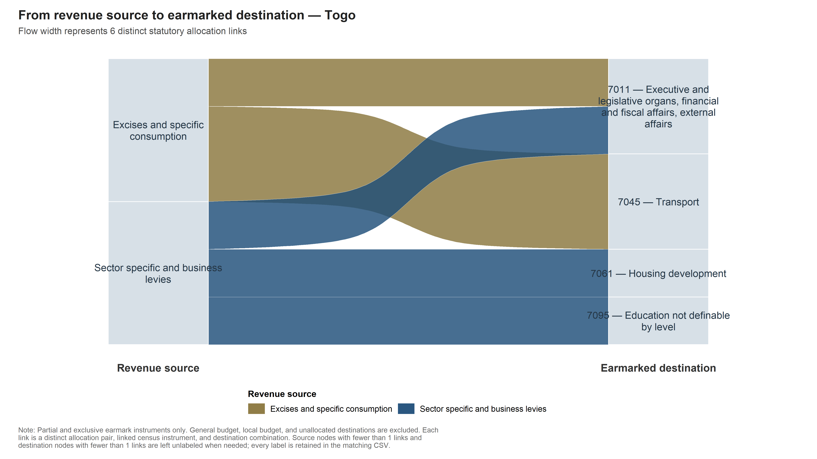
Do countries use earmarking in fundamentally different ways?
Stylized facts
International Monetary Fund | African Department
31

Slide 34
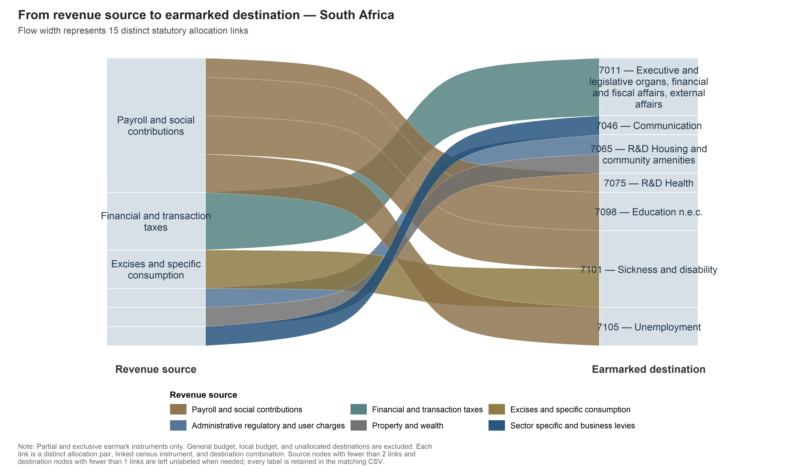
Do countries use earmarking in fundamentally different ways?
Stylized facts
International Monetary Fund | African Department
32

Slide 35
Do countries use earmarking in fundamentally different ways?
Conclusion
International Monetary Fund | African Department
33

Slide 36
Do countries use earmarking in fundamentally different ways?
Conclusion
International Monetary Fund | African Department
34

Slide 37
Do countries use earmarking in fundamentally different ways?
Conclusion
International Monetary Fund | African Department
35

Slide 38
Do countries use earmarking in fundamentally different ways?
Conclusion
International Monetary Fund | African Department
36

Slide 39
A new legal measurement layer for earmarking in Sub-Saharan Africa
Conclusion
The project establishes where statutory earmarking exists and how it is designed. The next step is to determine whether these legal commitments translate into revenue and spending outcomes.
CONTRIBUTION
New de jure inventory of statutory revenue assignments across 19 SSA countries
Comparable distinction between unrestricted assignments, partial earmarks and exclusive earmarks
Auditable methodology linking revenue instruments to statutory destinations to legal evidence
WHAT THE NEW DATA SHOW
19 countries · 209 partial / exclusive earmarks
Earmarking prevalence varies substantially across countries
Both partial and exclusive designs are common
Transport is the largest beneficiary sector
LIMITS
De jure, not de facto: no data on actual collection, transfer or execution
Count-based: measures instruments, not the share of revenue earmarked
Current-law snapshot: no reform history or causal identification
Coverage depends on the legal texts available per country
NEXT STEPS
Legal design → execution → additionality → outcomes
Match legal earmarks to revenue collections and budget execution
Build historical legal panels around creation, reform and repeal
Extend coverage where legal sources are fragmented
International Monetary Fund | African Department
37

Slide 40
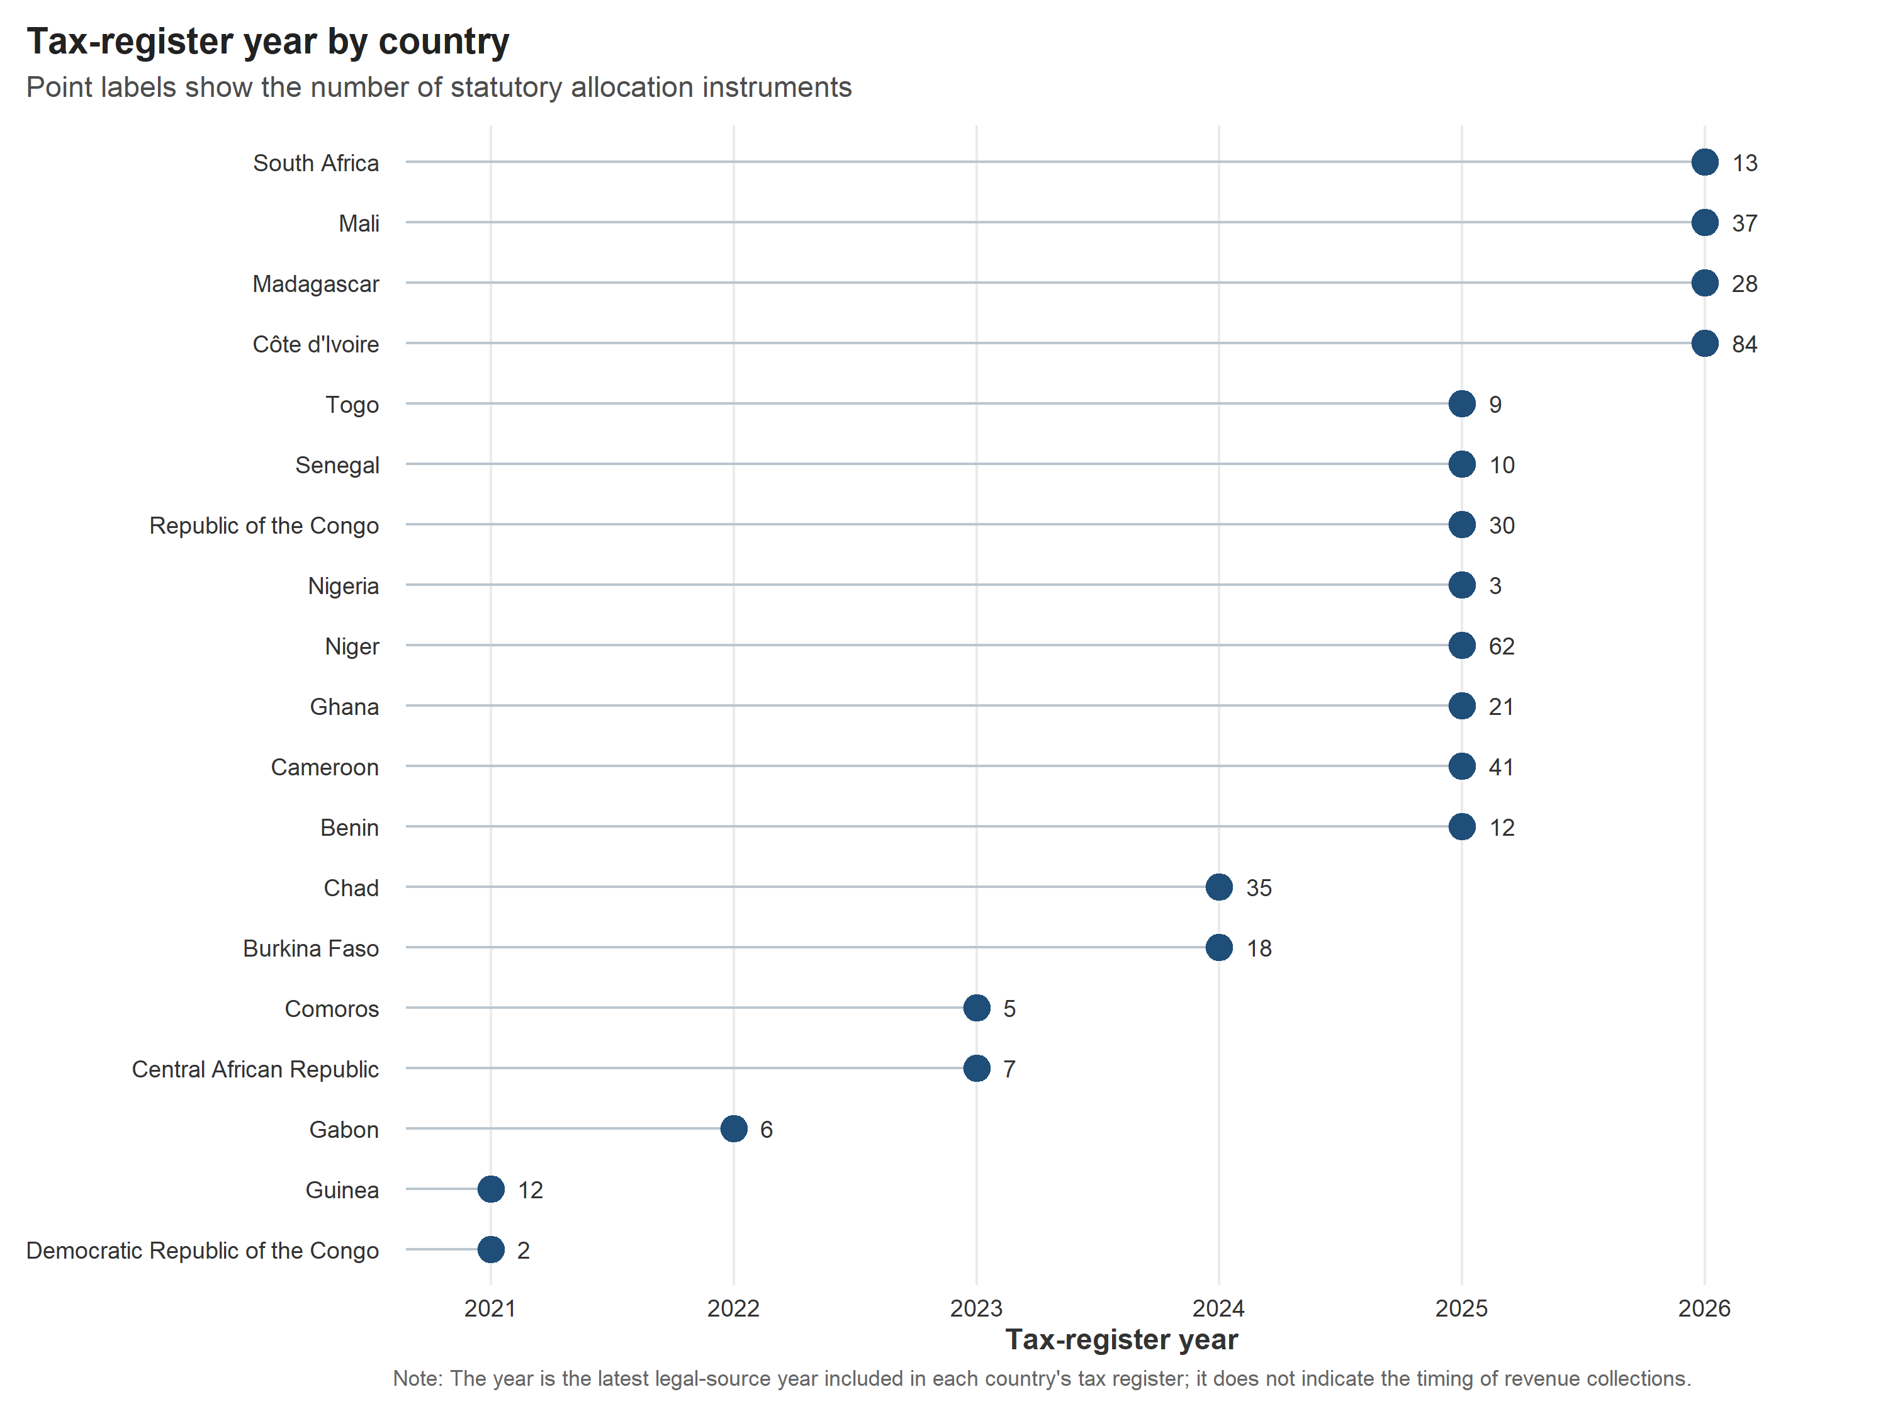
All extracted revenue instruments and years of documents used
Stylized facts
International Monetary Fund | African Department
38

Slide 41
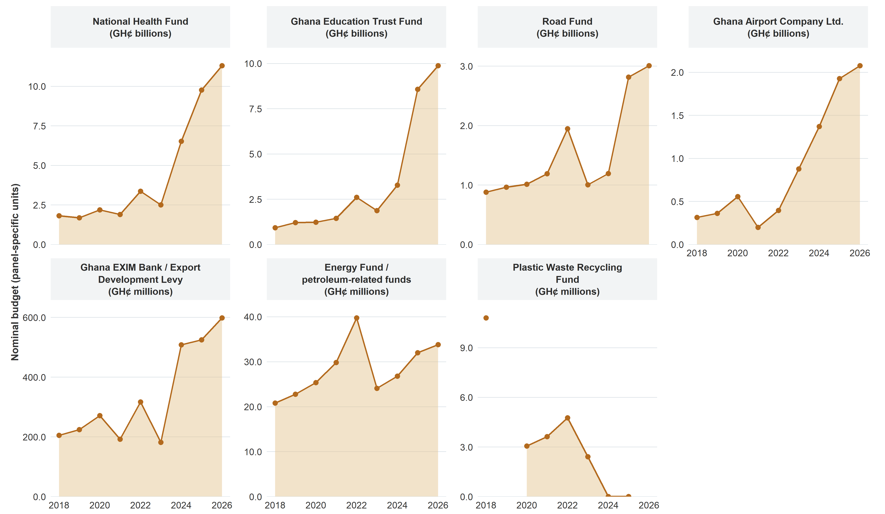
Ghana Illustration – Budget rigidity
Stylized facts
Budget allocations to earmarked in Ghana cidis 2018 - 2026
International Monetary Fund | African Department
39

Slide 42
METHODOLOGY · 6
What the counts can, and cannot, support
What it supports
What it does not support
✓
The legal shape of the system: which instruments exist and which are dedicated, in enacting law.
Not execution: de jure only, not money collected, transferred or spent.
✓
A defensible prevalence ratio: a share of instruments carrying a strict earmark, each counted once.
Not a share of revenue: a count of instruments, not the earmarked fraction of revenue.
✓
Comparison under a declared definition: alternatives tested on the same anchored records.
Not a time path: a current-law snapshot; reform paths need dated corpora.
✓
A reproducible, audited snapshot: every figure traceable to a clause, a page and a coverage check.
Not a zero where a text is missing: missing subordinate legislation is unobserved, not absence.
International Monetary Fund | African Department
40

Slide 43
What we measure — and what it yields
Contribution & method
We build database covering 19 countries, 435 assigned revenue instruments
209 earmarked instruments and 433 allocation channels attached to them
UNIT OF ANALYSIS
Revenue instrument
Enacting assignment
Recipient / purpose
one revenue source
what the law says
where proceeds go
LEGAL CORPUS ARCHITECTURE
FRANCOPHONE
Consolidated tax code (CGI) at the core
Source instruments and most allocation provisions sit inside one large corpus.
Deep within-document retrieval
ANGLOPHONE
Relevant law spread across several Acts
Tax · Levy · Fund · Finance Acts: charging provision and destination may sit in different documents.
Cross-document reconstruction
International Monetary Fund | African Department
41
Notes:
Headline database counts (19 / 435 / 209 / 433) are provisional production values from the current-law legal snapshot. They will be refreshed once the analytical dataset is frozen. Each figure sits in its own named text box (COUNT_countries, COUNT_assigned_instruments, COUNT_earmarked_instruments, COUNT_allocation_channels) so the numbers can be updated without touching the layout.
435 revenue instruments carry at least one statutory assignment; only 209 of those are partially or exclusively earmarked. Assignment is not earmarking. The 433 figure counts allocation channels, not instruments. The pooled prevalence result (N/D) is held back for the results section.

Slide 44
Why constrain revenue when fiscal space is already tight?
Motivation
The earmarking of taxes refers to the designation of fund, either from a single tax base or from a wider pool of revenue, to a particular end use.
Pros | SSA specificities | Cons | SSA specificities
Increases taxpayer acceptance | Low acceptance | Limits budget flexibility | Weak PFM and budget execution
Enhances transparency and trust | Low transparency and trust | May cause inefficient allocations | Inefficient allocations
Guarantees funding for priorities | High level of leaks / corruption | Complicates fiscal and cash management | Tight fiscal and cash management
Encourages program efficiency | Inefficient programming | Risks underfunding if revenues fall | Budget often underfunded
Facilitates new tax implementation | Low tax base and compliance | May reduce democratic budget control | Lower level of democracy
International Monetary Fund | African Department
42

